Slide 1


The North Face ecommerce
Machine Learning

Slide 2
Context
Tasks
Problem: E-commerce platform wants to boost its online sales
Process the product descriptions into a TF-IDF matrix
Solution 1: deploy a recommender system for the products catalogue
Use unsupervised learning to make clusters of similar products
Solution 2: Improve the catalogue structure using topic extraction
Design a recommender system to find items similar to the selection
Dataset: 500 product descriptions gathered from the website
Extract topics from descriptions using latent semantic analysis

Slide 3
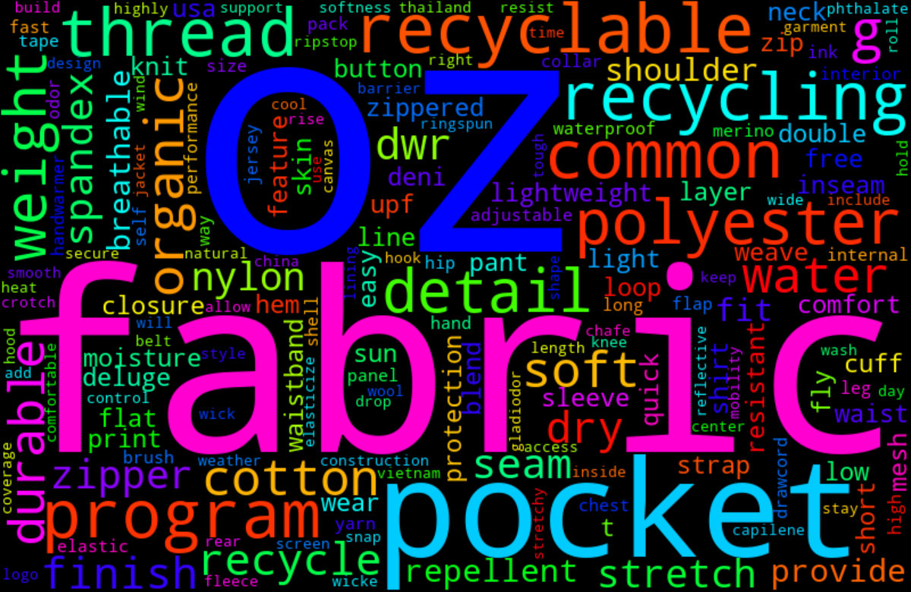
Descriptions overview
500 product descriptions
About 100 words each
Gathered by web scraping
Corpus preprocessing
Remove HTML tags
Remove punctuation
Remove numbers
Remove stop words
Strip diacritics and casefold
Garment descriptions
Lemmatize words

Slide 4
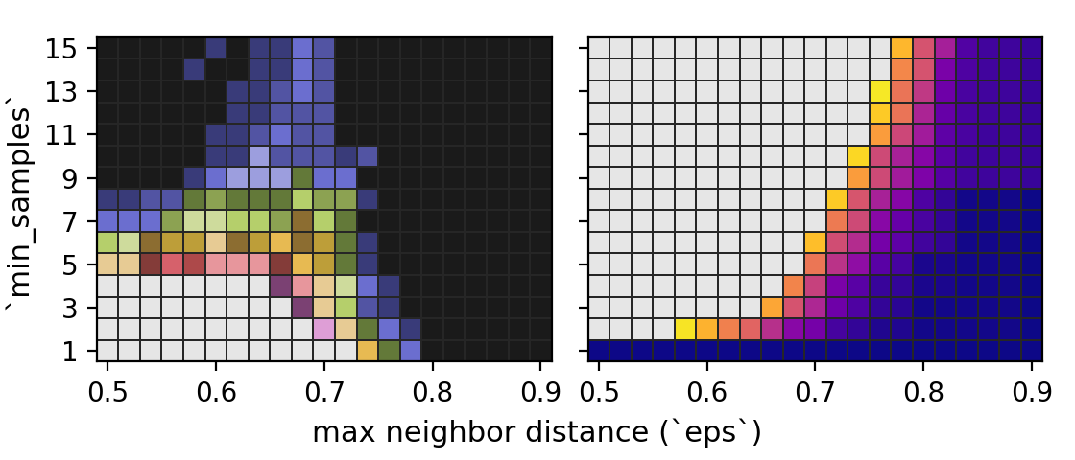
Clustering : Methods
Convert description corpus to TF-IDF
Difficult to find good parameters!
2 methods: DBSCAN / HDBSCAN
DBSCAN
16 clusters
Optimize parameters
48 outliers (10%)
Limit the number of outliers
Make about 10 clusters
HDBSCAN
DBSCAN grid search
18 clusters
80 outliers (16 %)
Strong cluster inhomogeneity
Largest cluster : about 180 items
Smallest cluster : 4 items

Slide 5
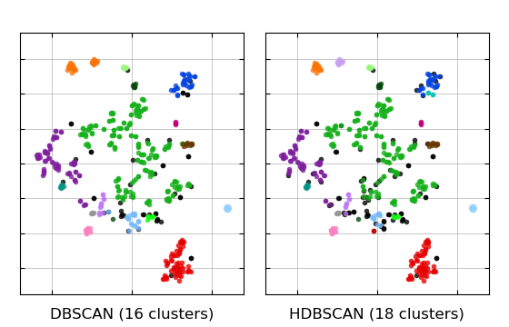
Clustering : t-SNE Vizualization
Low dimensional embedding
t-distributed Stochastic Neighbor Embedding (t-SNE)
Similar clusterization with
DBSCAN and HDBSCAN
Small well-defined clusters
Large central aggregate
One big cluster (180 items)
Intertwined with outliers

Slide 6
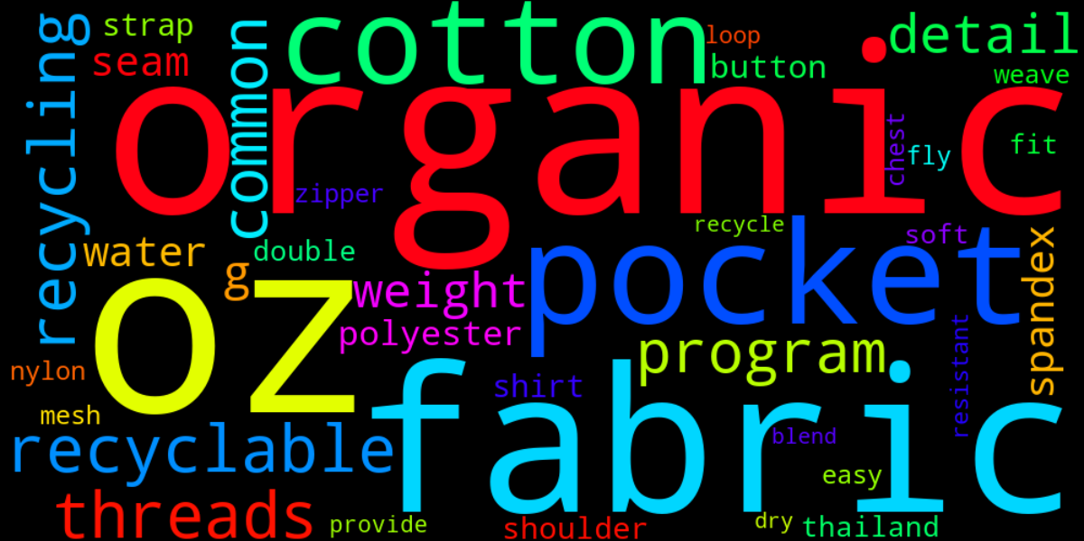
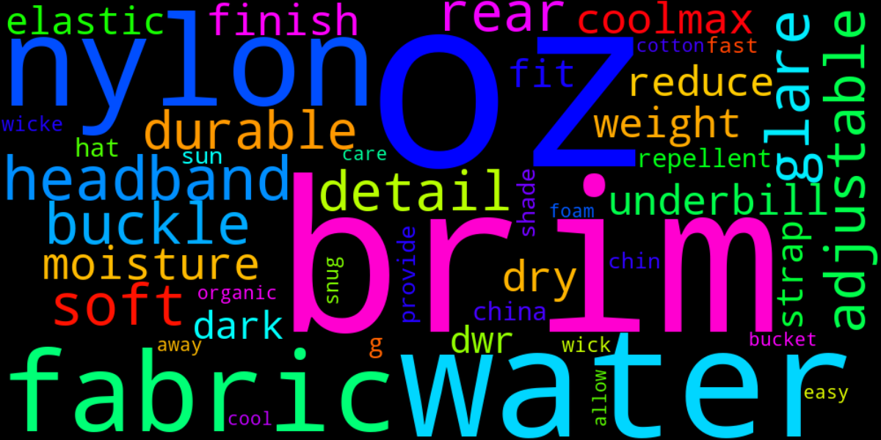
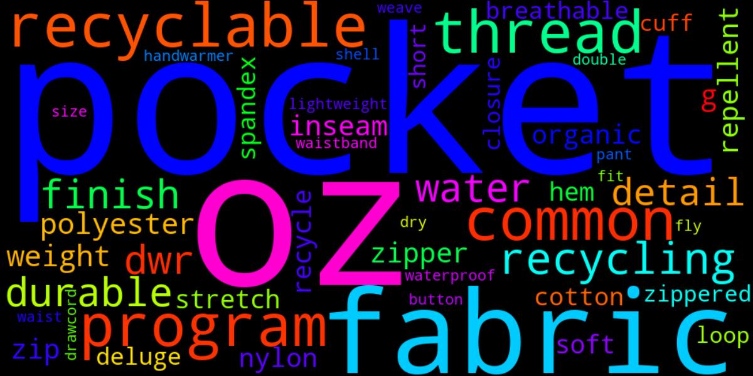
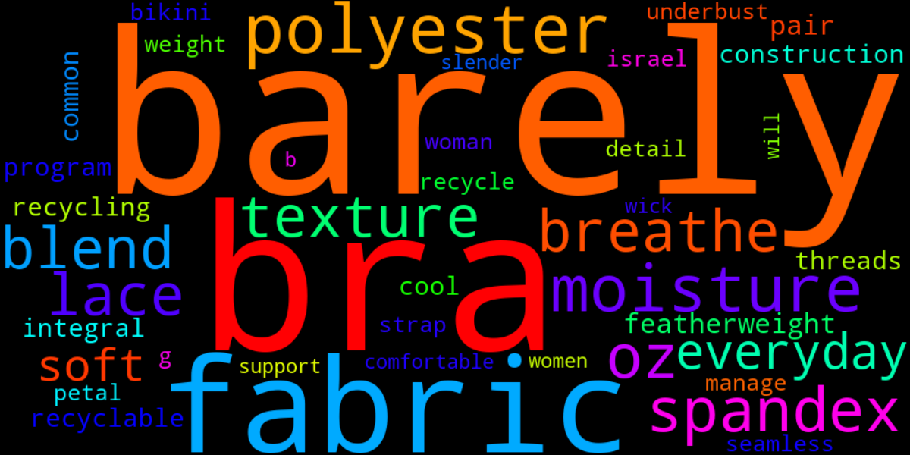
Clustering : Wordcloud visualization
Clusters difficult to interpret
Clear garment categories
Outliers
Brims
Largest cluster
Bras

Slide 7
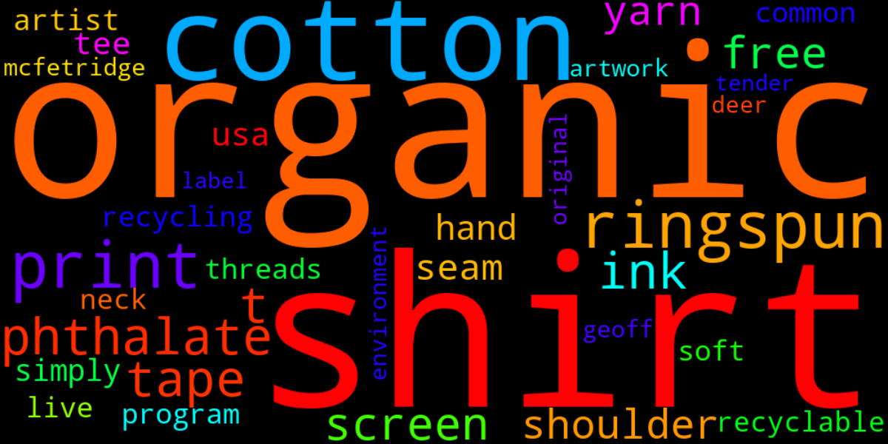
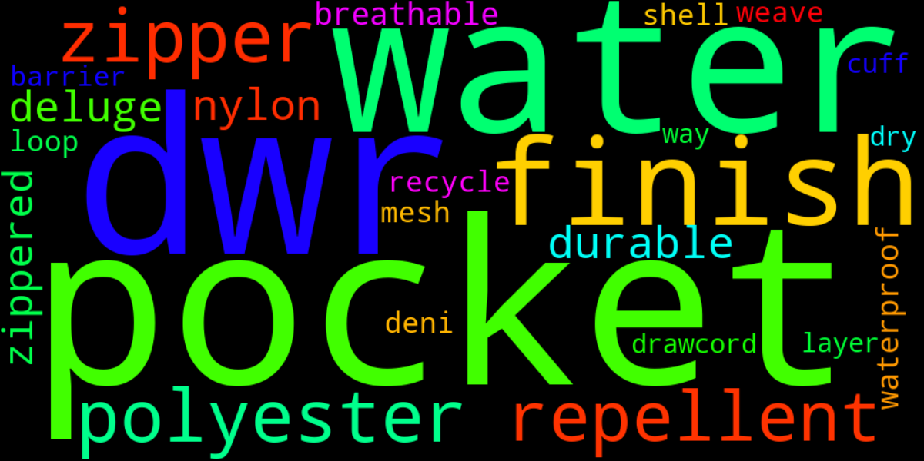
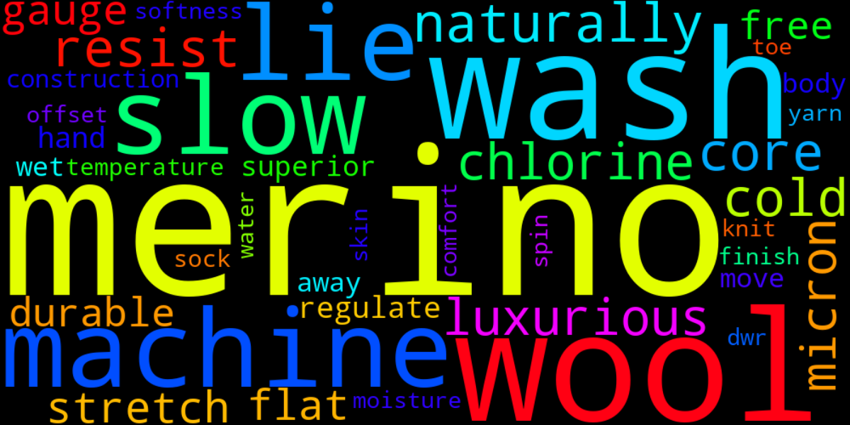
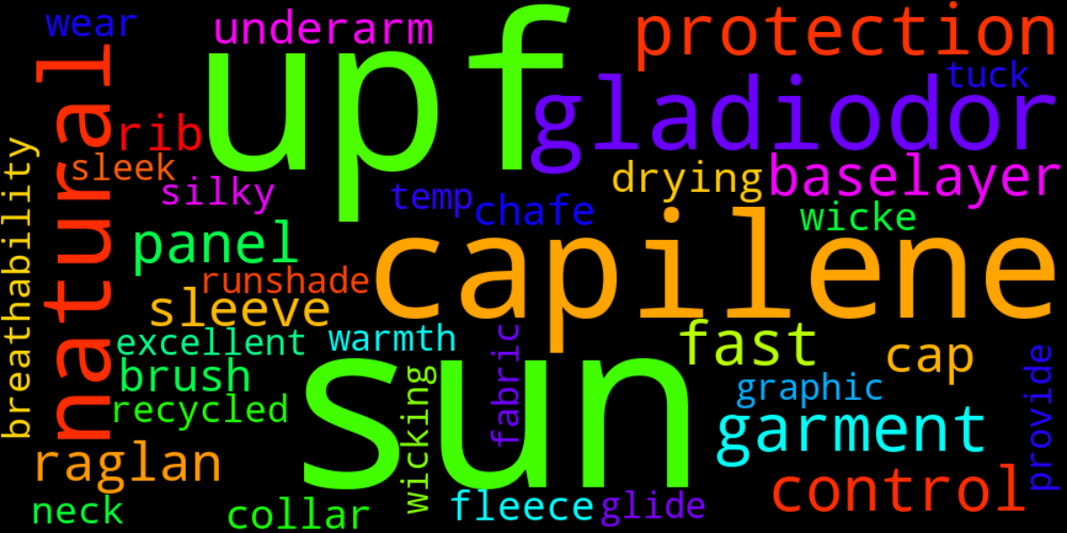
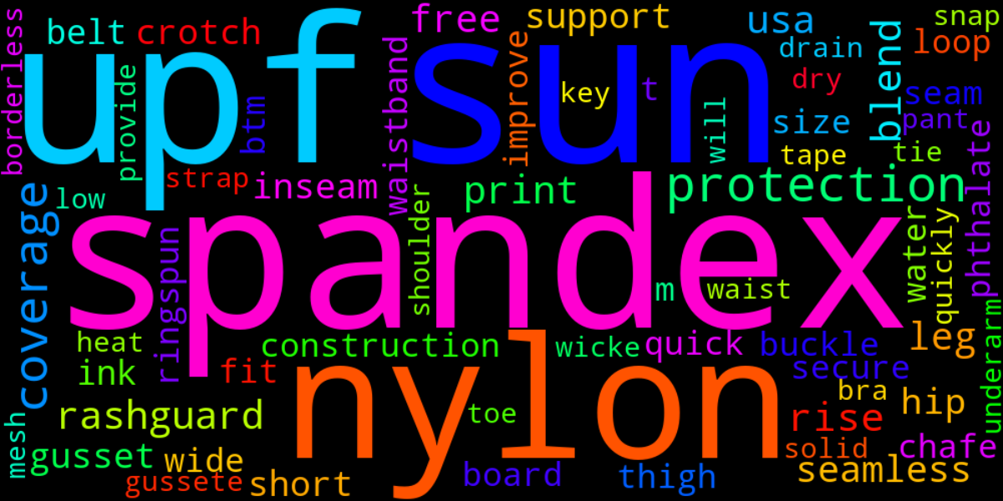
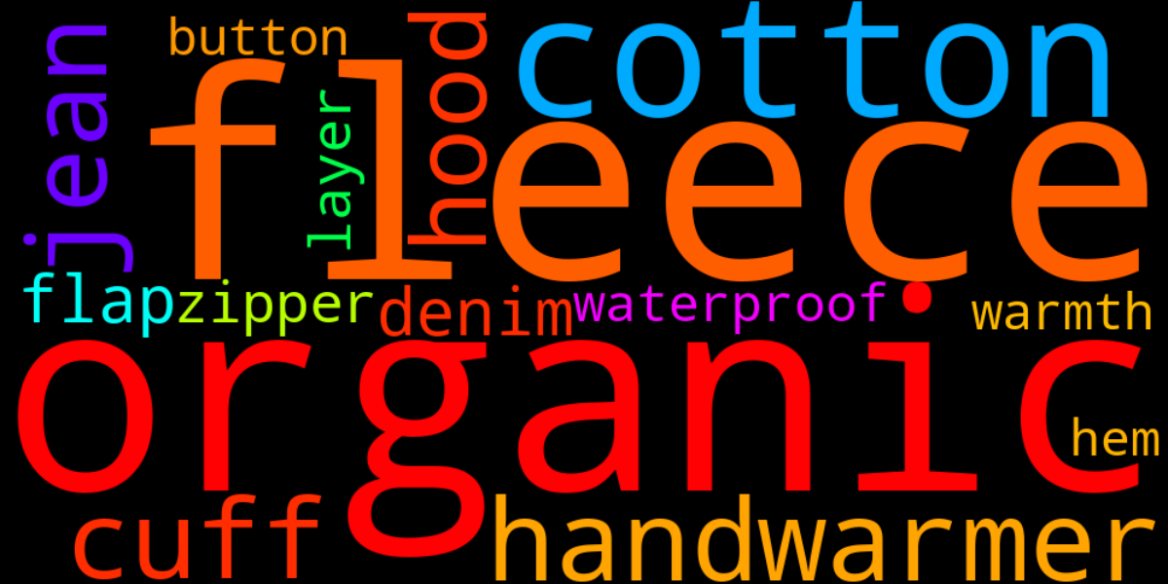
Topic extraction
Natural
Synthetic
-
Truncated SVD
Get eigenvectors of the covariance matrix
Cold
Hot
Representation of the corpus topics
-
Visualize as wordclouds
Split positive and negative components
Hot / Synthetic
Cold / Organic
-

Slide 8
Conclusion
Good clusterization and topic extraction from only 500 descriptions
Limited clustering performance
Mixing of topics from different semantic fields
(eg garment type and garment composition)
For a better clustering / topic extraction
More descriptions
Split descriptions (garment usage / composition / ...)

Slide 9

Thanks!

